Slide 1
Thermophysical property dissemination utilizing an XML-based standard
249th ACS National Meeting & Exposition
Denver, CO
March 25, 2015
Kenneth Kroenlein, Robert Chirico,
Vladimir Diky, Ala Bazyleva,
Joseph Magee, Chris Muzny
TRC Group
NIST
Boulder, CO

Slide 2
Major Milestones in Development of ThermoML
2003
Article: Experimental Data (JCED 2003, 48(1), 2-13)
Article: Uncertainties (JCED 2003, 48(5), 1344-1359)
IUPAC Project No. 2002-055-3-024 Start
Journal Collaboration: J. Chem. Eng. Data
2004
Article: Modeled Data (JCED 2004, 49(3), 381-393)
Journal Collaboration: J. Chem. Thermodyn.
2005
Journal Collaboration: Fluid Phase Equilib.
Journal Collaboration: Thermochim. Acta
Journal Collaboration: Int. J. Thermophys.
2006
IUPAC Project No. 2002-055-3-024 Completion (Pure Appl. Chem. 2006, 78(3), 541–612)
8 Papers at the 231st ACS National Meeting (Atlanta)
2007
IUPAC Project No. 2007-039-1-024 Start
2010
Article: Biomaterials (JCED 2010, 55(4), 1564-1572)
2011
Article: Speciation and Complex Equilibria (JCED 2011, 56(2), 307-316)
IUPAC Project No. 2007-039-1-024 Completion (Pure Appl. Chem. 2011, 83(10), 1937-1969)

Slide 3
Experimental data captured from all literature

Slide 4
Data growth is exponential
Annual growth of data in thermophysical properties of small molecular organics has been near 6 % per year for 200 years
Doubles every 12 years
Across all data collection in science, 4.7 % per year
Doubles every 15 years Scientometrics 2010, 84, 575-603

Slide 5
Challenge 1: Classes of interest shift e.g. ionic liquids, biofuels, pharmaceuticals
1-hexyl-3-methylimidazolium
bis[(trifluoromethyl)sulfonyl]imide
CAS is adding new substances at the rate of more than 15,000 per day.
http://www.cas.org/about-cas/cas-fact-sheets/registry-fact-sheet

Slide 6
Challenge 2: Data space is very sparsely populated
Number of measured property values
Compound number
Compound number

Slide 7
Challenge 3: Longevity
High-quality measurements of thermophysical properties have a very long “shelf life”
Some properties published in the late 19th century are still of high value today (e.g. liquid-gas critical properties and solubilities)
The era of high-precision (low uncertainty) property measurements for pure compounds began near 1930
High-precision property measurements are relatively rare today
Measurements are done much faster, but uncertainties are often much larger (sometimes OK, but sometimes not)
In this field,
Data Quality ≠ f(Publication Date)

Slide 8
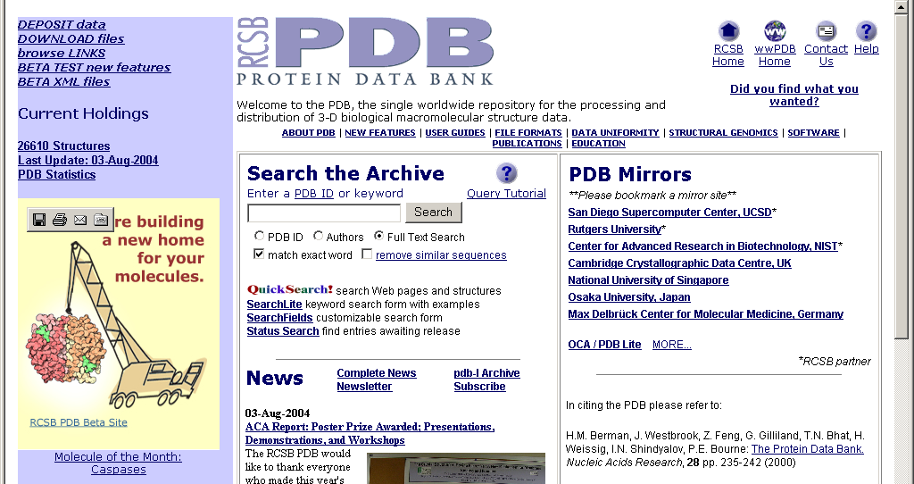
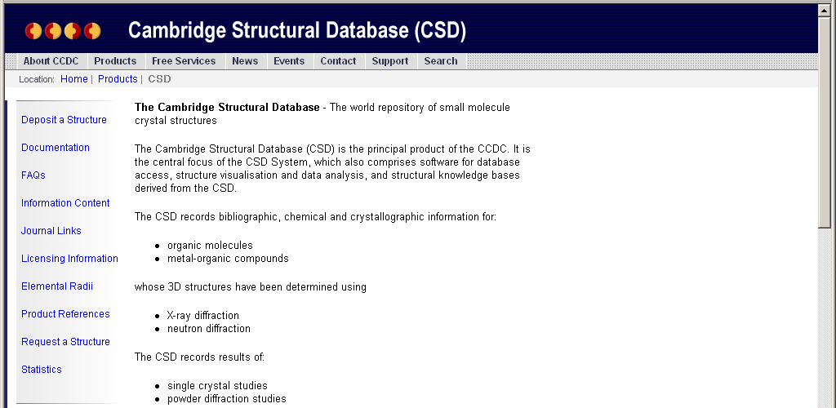
Successful global data delivery processes outside the field of thermodynamics
Protein Data Bank (PDB): Protein structure submission and retrieval
Cambridge Structural Database (CSD): Submission and retrieval of crystal structures for “small” molecules

Slide 9
Major Milestones in Development of ThermoML
2003
Article: Experimental Data (JCED 2003, 48(1), 2-13)
Article: Uncertainties (JCED 2003, 48(5), 1344-1359)
IUPAC Project No. 2002-055-3-024 Start
Journal Collaboration: J. Chem. Eng. Data
2004
Article: Modeled Data (JCED 2004, 49(3), 381-393)
Journal Collaboration: J. Chem. Thermodyn.
2005
Journal Collaboration: Fluid Phase Equilib.
Journal Collaboration: Thermochim. Acta
Journal Collaboration: Int. J. Thermophys.
2006
IUPAC Project No. 2002-055-3-024 Completion (Pure Appl. Chem. 2006, 78(3), 541–612)
8 Papers at the 231st ACS National Meeting (Atlanta)
2007
IUPAC Project No. 2007-039-1-024 Start
2010
Article: Biomaterials (JCED 2010, 55(4), 1564-1572)
2011
Article: Speciation and Complex Equilibria (JCED 2011, 56(2), 307-316)
IUPAC Project No. 2007-039-1-024 Completion (Pure Appl. Chem. 2011, 83(10), 1937-1969)

Slide 10
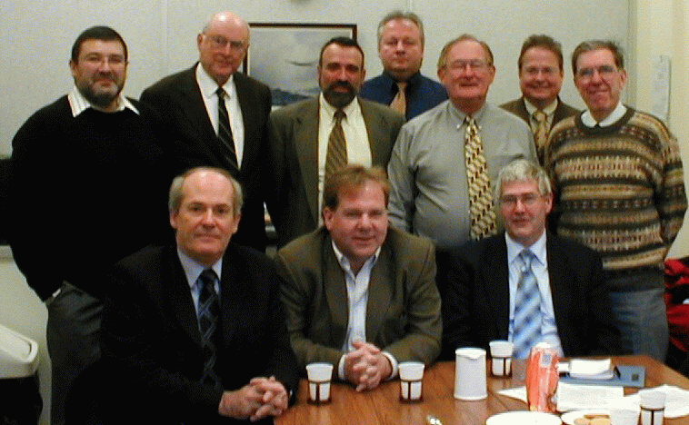
Participants of the Task Group meeting for IUPAC project 'XML-based IUPAC standard for experimental and critically evaluated thermodynamic property data storage and capture'. Prof. W. A. Wakeham, Dr. A. R. H. Goodwin, Dr. A. I. Johns; Dr. M. Satyro,
Dr. D. Lide, Dr. M. Frenkel, Dr. M. Schmidt, Prof. K. N. Marsh,
Dr. J. W. Magee, Dr. J. H. Dymond

Slide 11
Scope of the Experimental Data Considered
Essentially all thermodynamic and transport properties are considered
Thermodynamic: densities, vapor pressures, heat capacities, critical properties, phase-transition properties, enthalpies of combustion/reaction, sound speed, etc.
Phase Equilibria: vapor-liquid, liquid-liquid, solid-liquid
VLE (pTxy, pTx, Txy, etc.), LLE, SLE, solubilities, etc.
Transport: viscosities, thermal conductivities, electrolytic conductivity, etc.
Properties in gas, liquid, crystal, glasses, multiphase equilbrium, etc.
Properties of reactions are included (combustion & solution calorimetry)
Properties of mostly organic and organic-like compounds with unique molecular and elemental composition, and no overall charge are considered (at this time)
This means…
no polymers
no properties of ions (i.e., acid dissociation constants)
no biological systems (i.e., binding constants, protein folding transitions, etc.)
no clathrates (i.e., materials that do not have unique elemental compositions)
yes for properties of ionic liquids, salt solutions, etc.

Slide 12
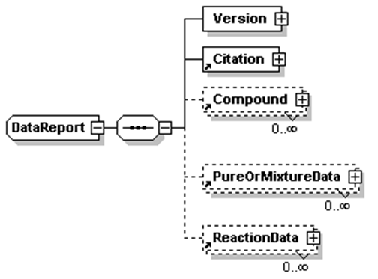
General Structure of ThermoML

Slide 13
Major Milestones in Development of ThermoML
2003
Article: Experimental Data (JCED 2003, 48(1), 2-13)
Article: Uncertainties (JCED 2003, 48(5), 1344-1359)
IUPAC Project No. 2002-055-3-024 Start
Journal Collaboration: J. Chem. Eng. Data
2004
Article: Modeled Data (JCED 2004, 49(3), 381-393)
Journal Collaboration: J. Chem. Thermodyn.
2005
Journal Collaboration: Fluid Phase Equilib.
Journal Collaboration: Thermochim. Acta
Journal Collaboration: Int. J. Thermophys.
2006
IUPAC Project No. 2002-055-3-024 Completion (Pure Appl. Chem. 2006, 78(3), 541–612)
8 Papers at the 231st ACS National Meeting (Atlanta)
2007
IUPAC Project No. 2007-039-1-024 Start
2010
Article: Biomaterials (JCED 2010, 55(4), 1564-1572)
2011
Article: Speciation and Complex Equilibria (JCED 2011, 56(2), 307-316)
IUPAC Project No. 2007-039-1-024 Completion (Pure Appl. Chem. 2011, 83(10), 1937-1969)

Slide 14

1. Experiment Planning
(Article Authors)
Start of
process
ThermoLit
Journal Support
Websites
A
2. Article Preparation and Submission (Article Authors)
NIST Literature Report
End
Reject
3. Journals (Editors)
4. Traditional Peer Review
End
Reject
5. Decision
Approve (not “Accept”)
6a. In-House Data Capture
(Student Associates)
B
6b. Guided
Data Capture
6c. ThermoData
Engine
NIST/TRC
SOURCE Database
NIST Data Report
7. Journals (Editors)
7a. Revisions (Authors)
End
Reject
8. Final
Decision
Accept
Publish
After publication
C
9. ThermoML Archive of
published experimental data
10. Data Users
End of
process

Slide 15
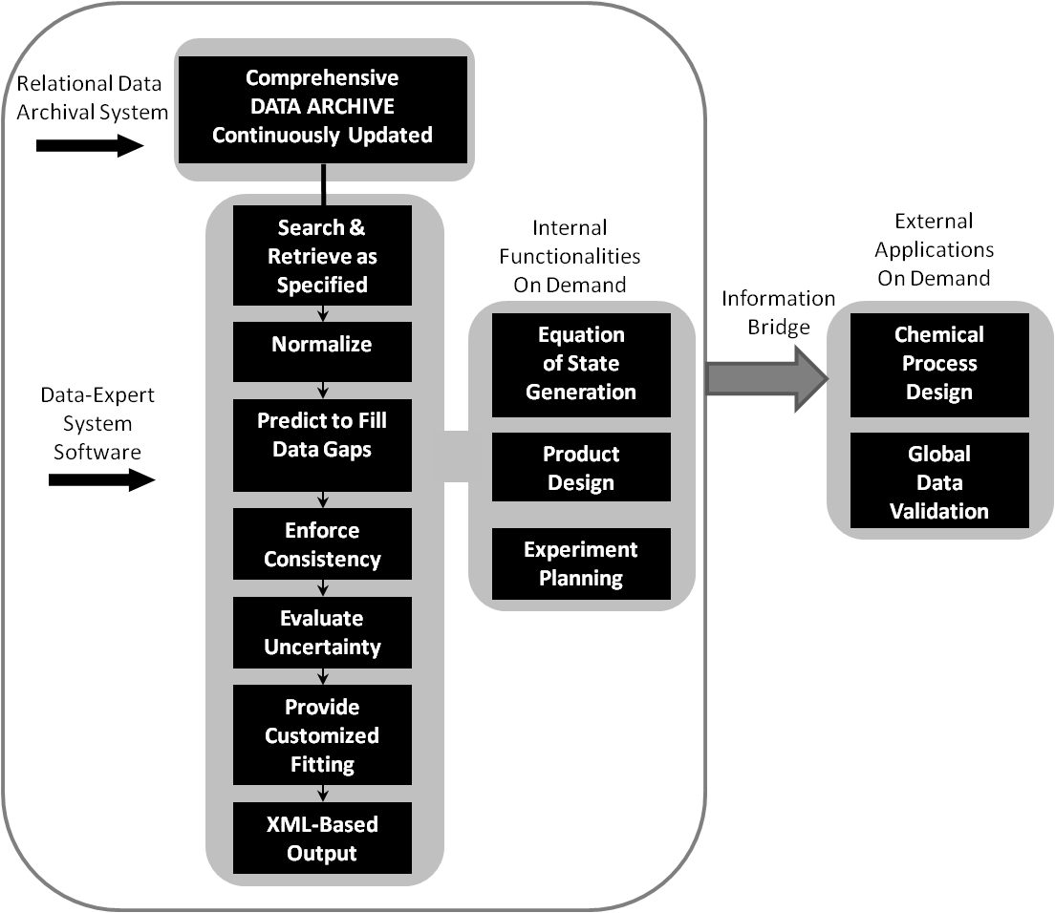
Dynamic data evaluation cycle
Requires
A trusted data archive with full, machine-interpretable metadata
Data-Expert System Software: software developed via systematic, test-driven analysis of real data systems
Delivers
A data expert backed by a well-curated library at the beck and call of engineers
Schematic representation of dynamic data evaluation performed by a user on demand as implemented in the NIST ThermoData Engine (TDE) (NIST SRD 103a and 103b)

Slide 16
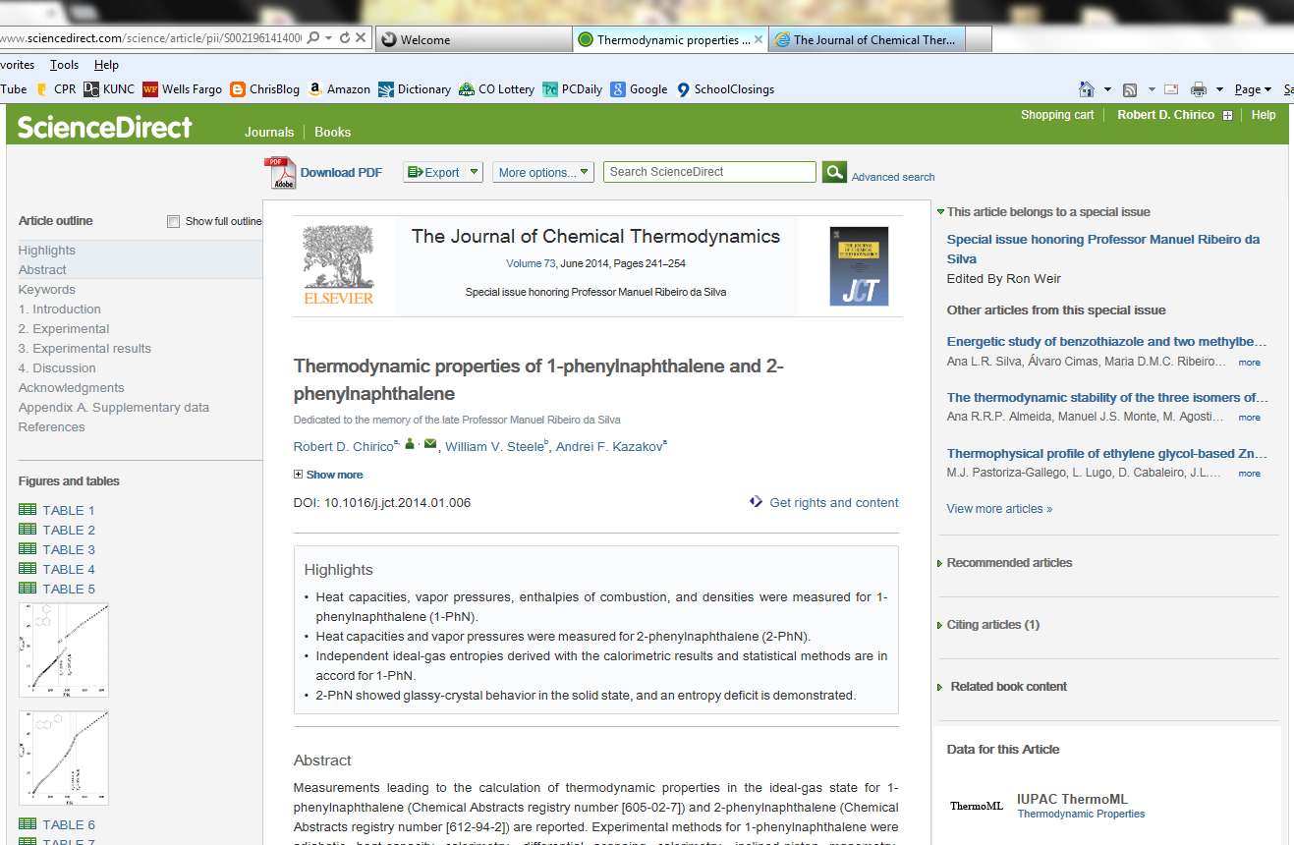

Slide 17
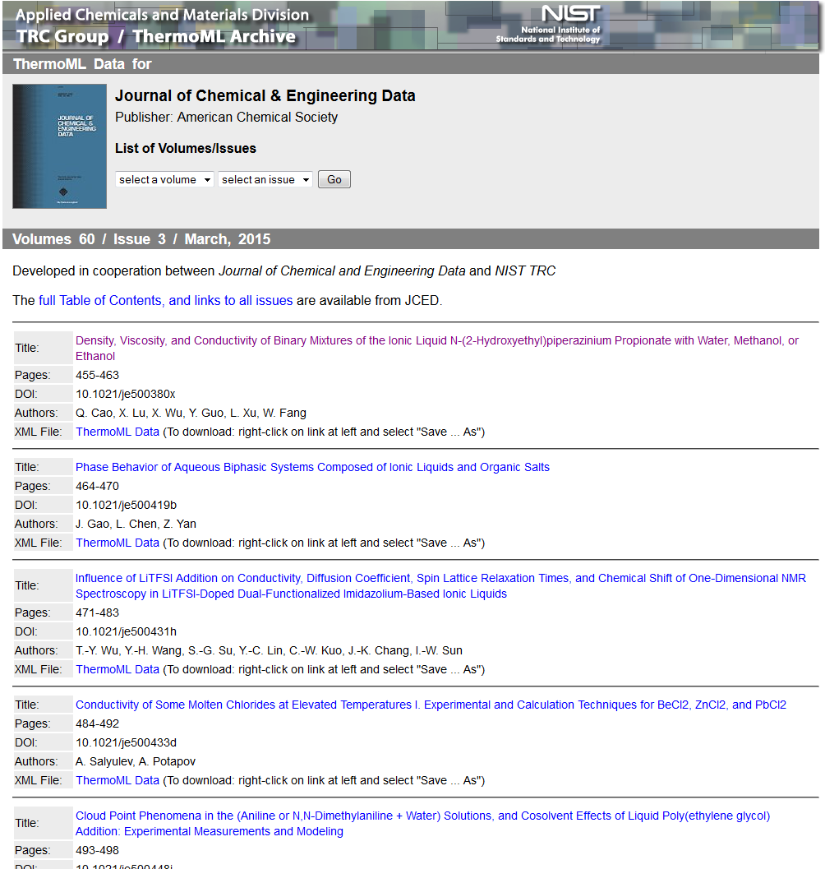
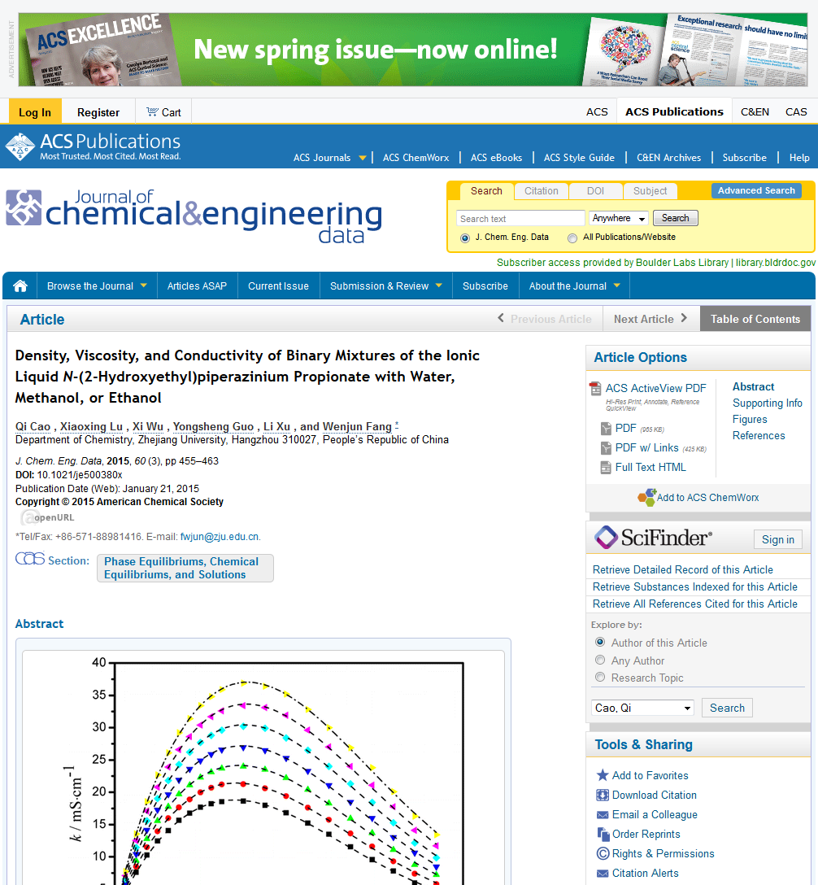

Slide 18
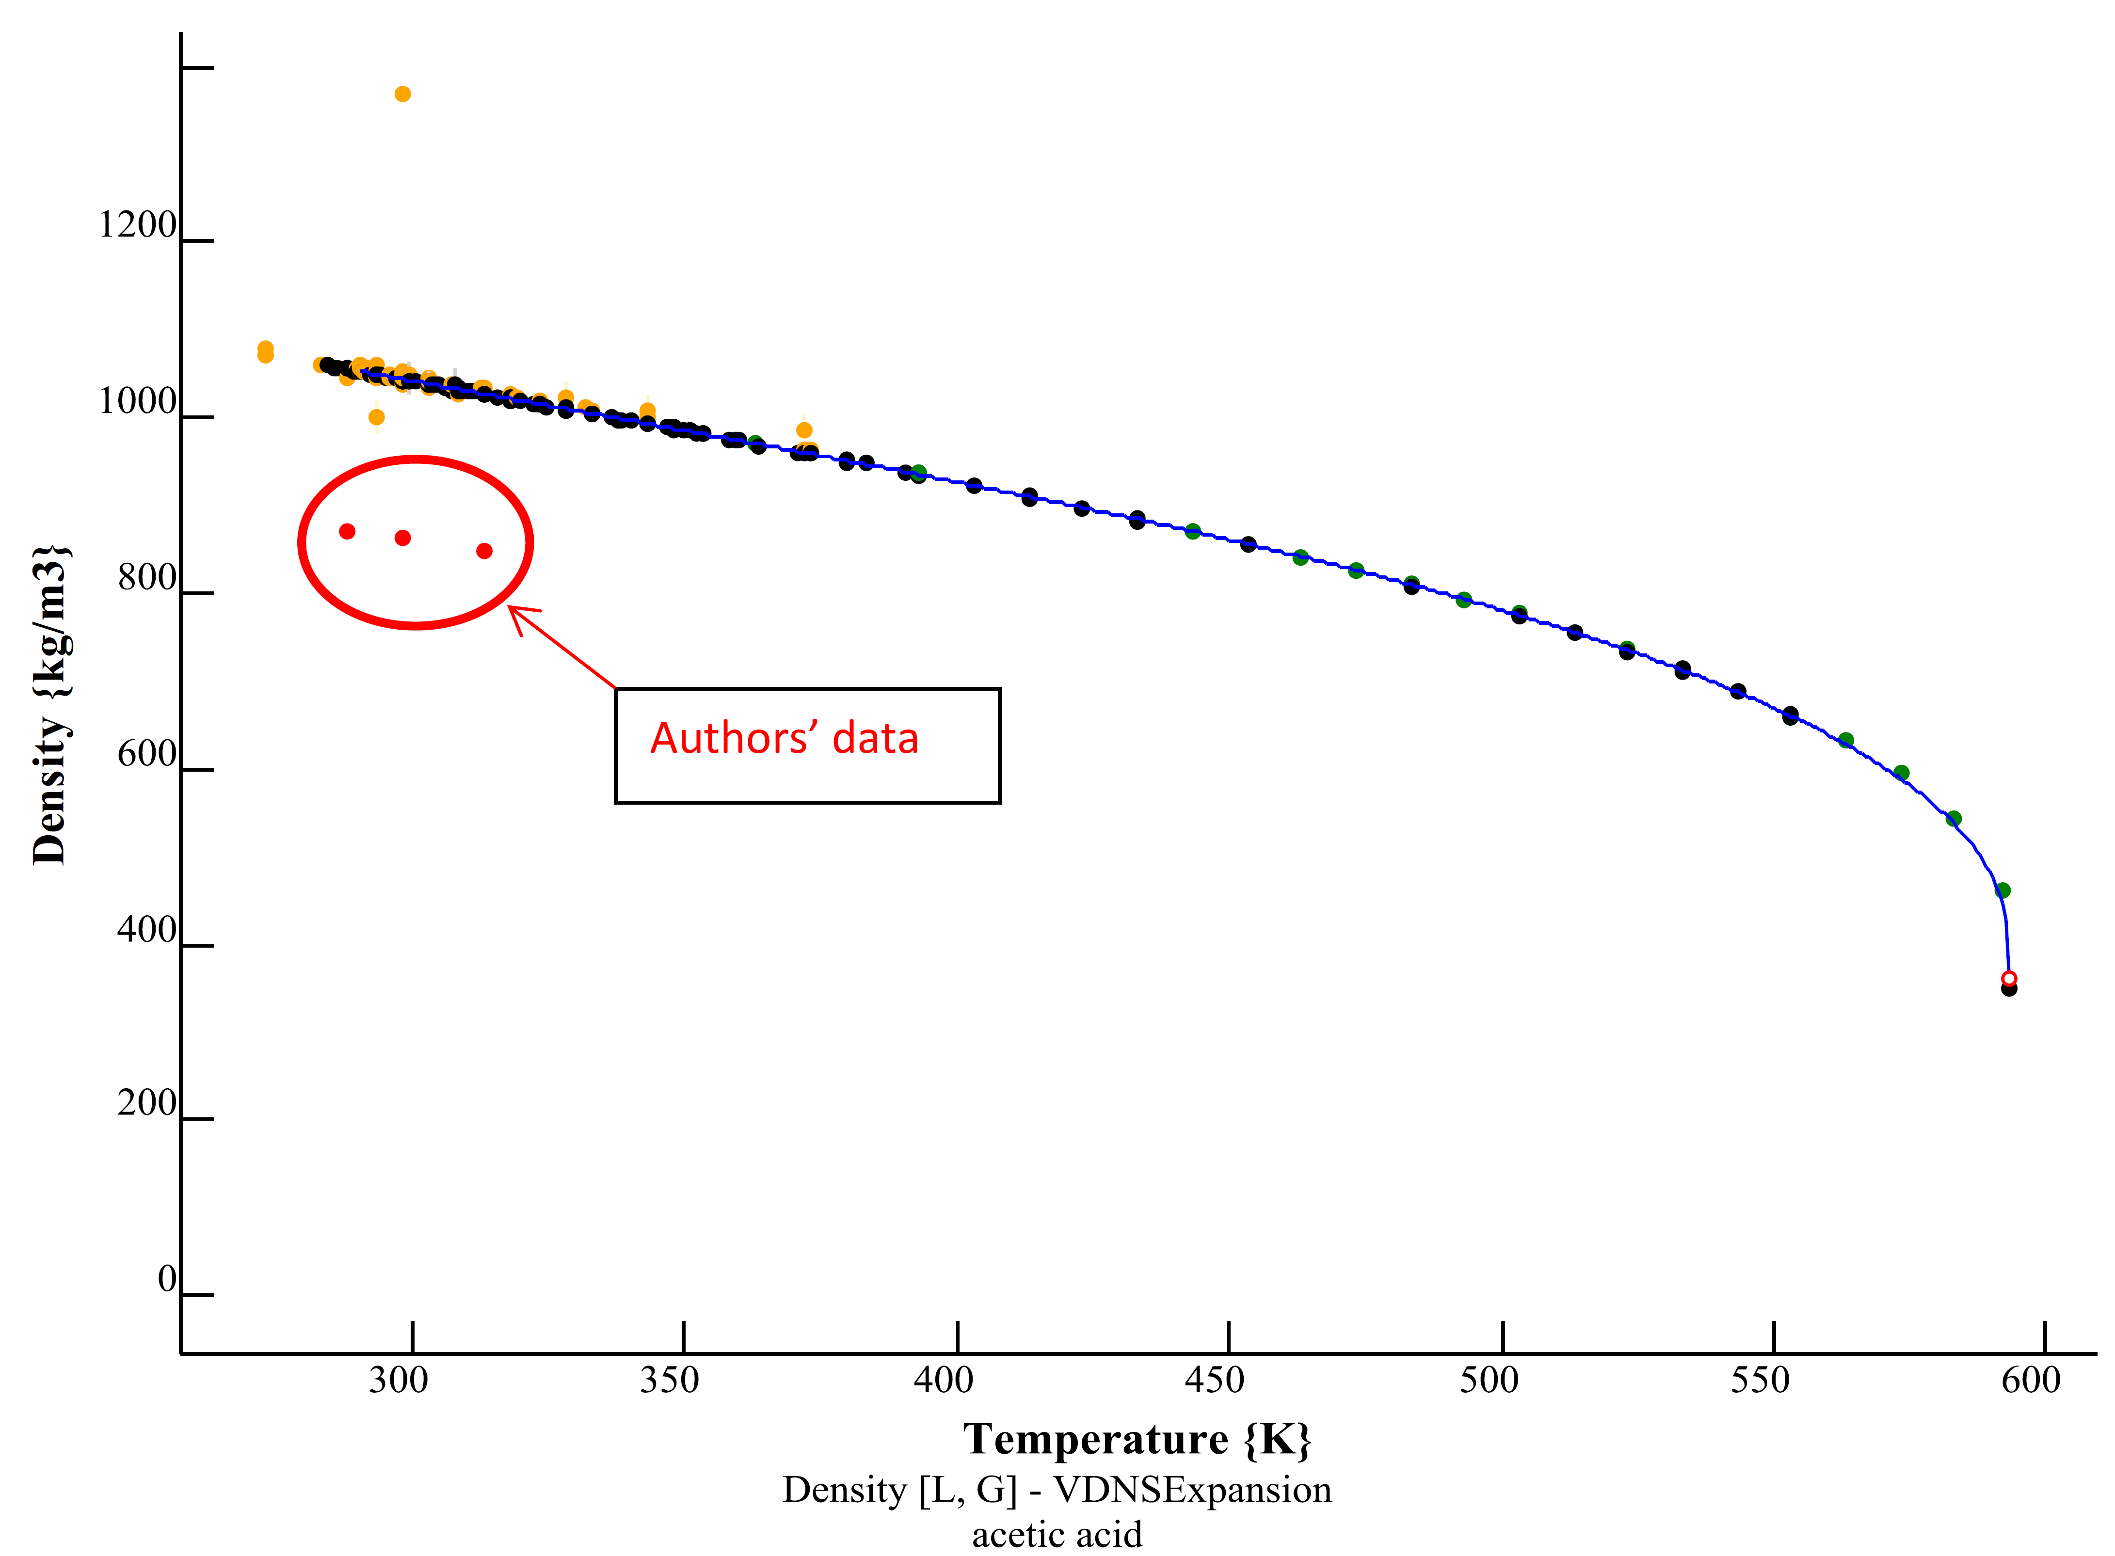
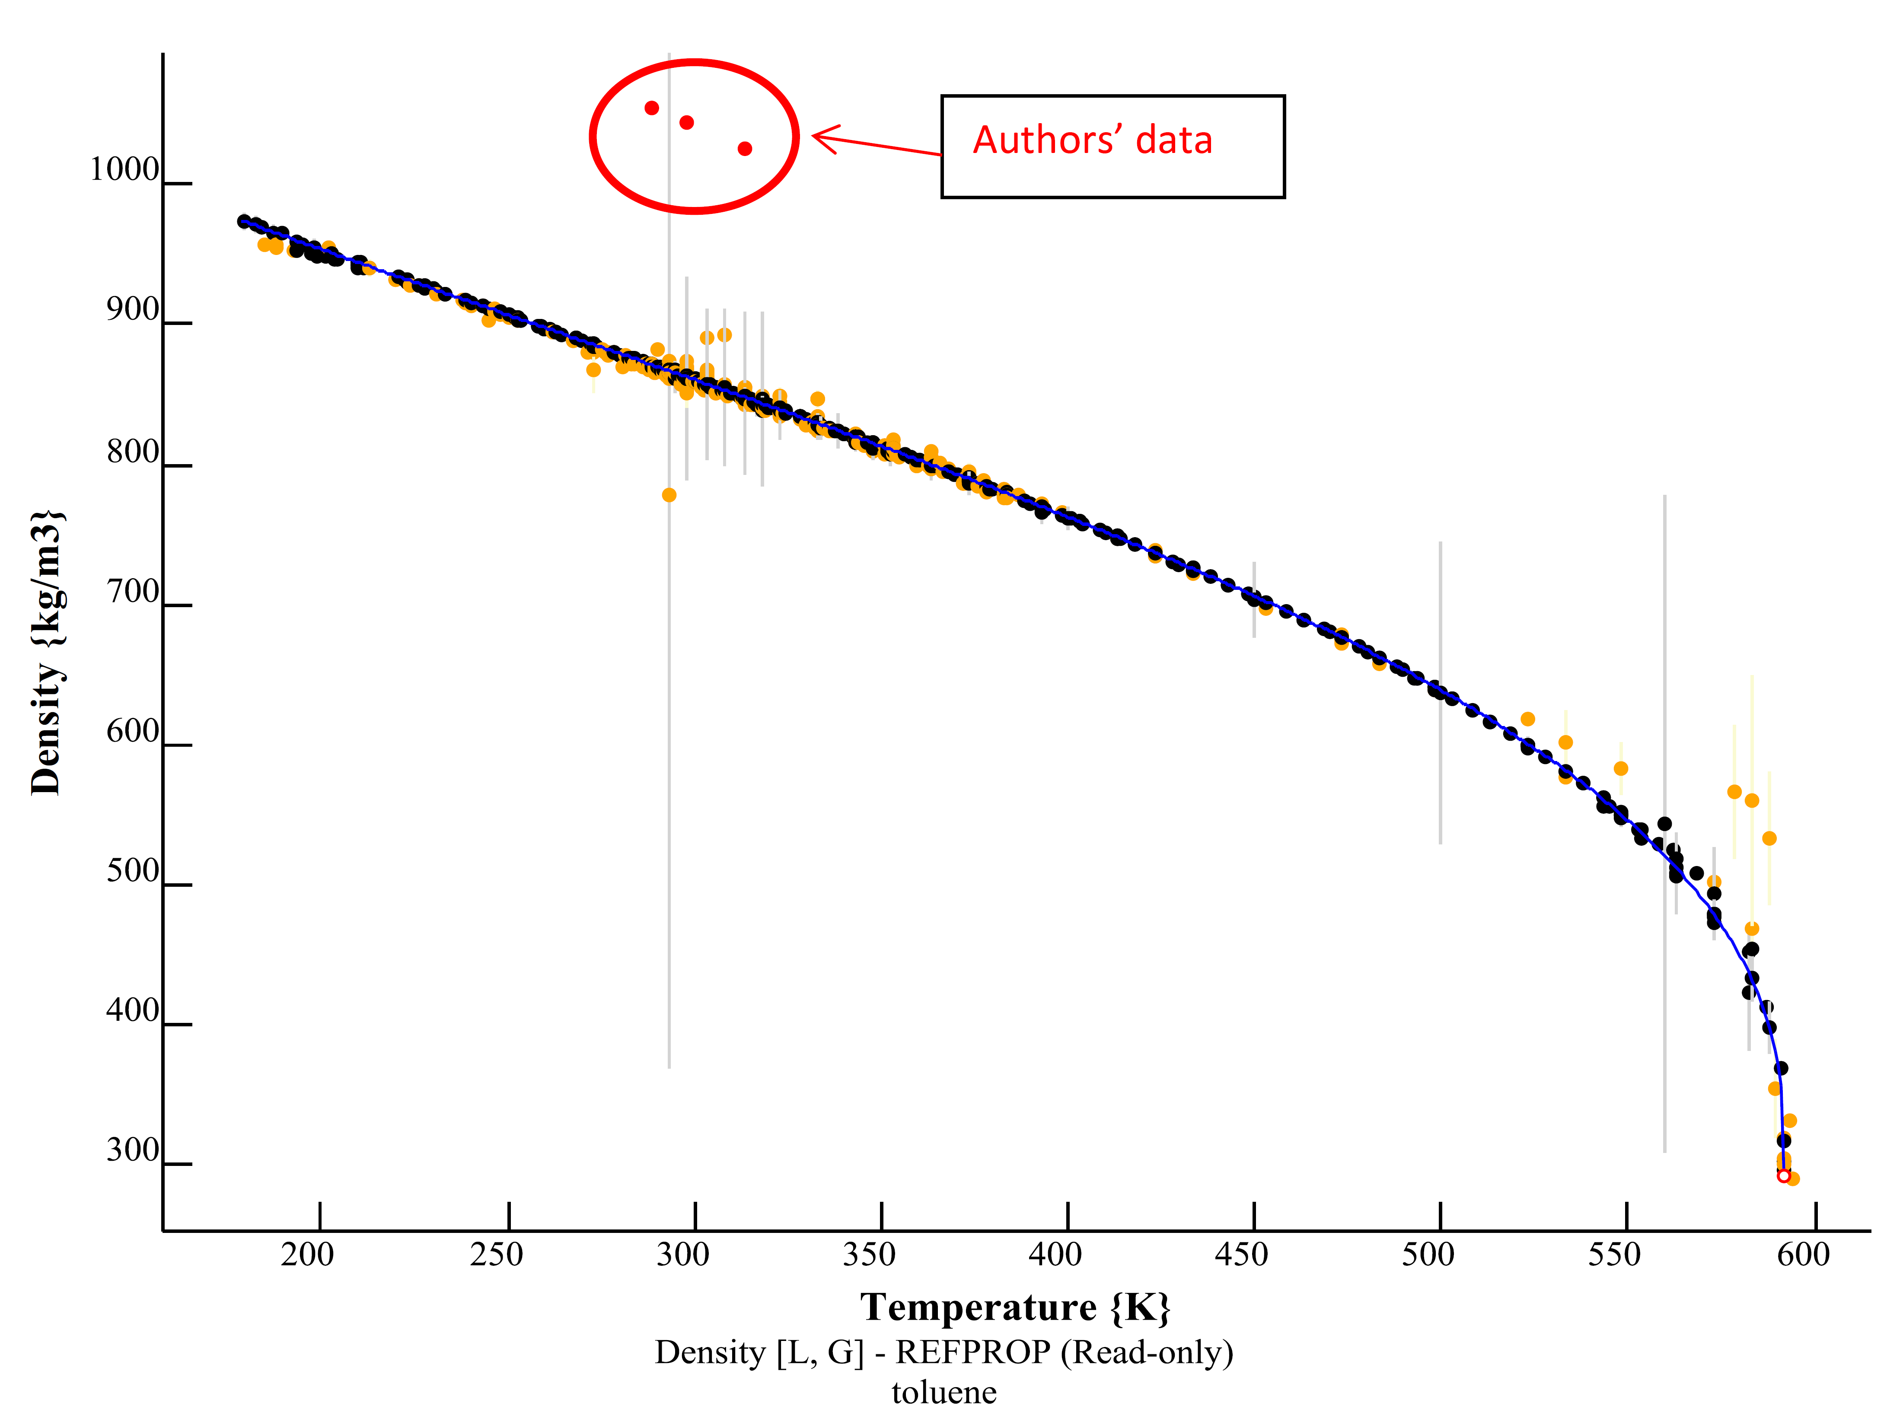
Data were accidentally swapped between toluene and acetic acid
The manuscript was correct before publication

Slide 19
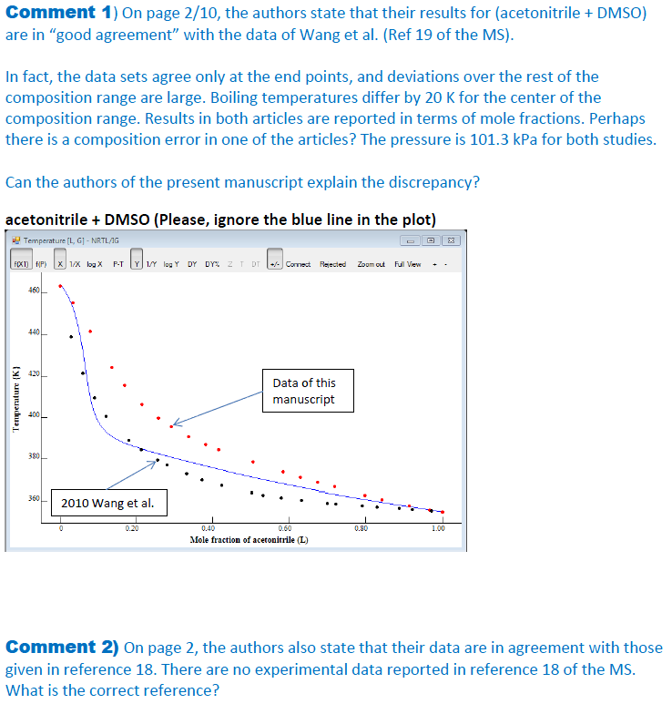
Bubble-point temperatures differ by 20 K in the middle of the composition range.
They also declared good agreement with an article that had no experimental data at all.

Slide 20
Approximately ⅓ of articles that reach the “approve” stage are found to contain significant problems that require further revision
This is the distribution of problems within that one third...
Problems found and corrected every year: ≈ 500
(often more than 1 problem/manuscript)

Slide 21
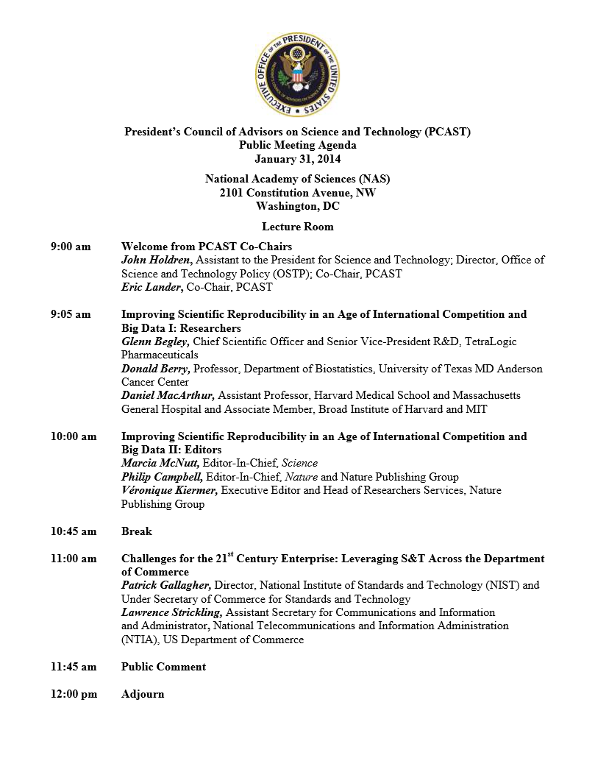
“the greatest likelihood of change is going to come from the journals and granting agencies.”
Nature 2012, 483, 531–533
Nature 2013, 497, 433-434

Slide 22
Major Milestones in Development of ThermoML
2003
Article: Experimental Data (JCED 2003, 48(1), 2-13)
Article: Uncertainties (JCED 2003, 48(5), 1344-1359)
IUPAC Project No. 2002-055-3-024 Start
Journal Collaboration: J. Chem. Eng. Data
2004
Article: Modeled Data (JCED 2004, 49(3), 381-393)
Journal Collaboration: J. Chem. Thermodyn.
2005
Journal Collaboration: Fluid Phase Equilib.
Journal Collaboration: Thermochim. Acta
Journal Collaboration: Int. J. Thermophys.
2006
IUPAC Project No. 2002-055-3-024 Completion (Pure Appl. Chem. 2006, 78(3), 541–612)
8 Papers at the 231st ACS National Meeting (Atlanta)
2007
IUPAC Project No. 2007-039-1-024 Start
2010
Article: Biomaterials (JCED 2010, 55(4), 1564-1572)
2011
Article: Speciation and Complex Equilibria (JCED 2011, 56(2), 307-316)
IUPAC Project No. 2007-039-1-024 Completion (Pure Appl. Chem. 2011, 83(10), 1937-1969)

Slide 23
Future Developments
Improve Discoverability
Interface and indexing were designed with the premise that users would know which article they were interested in
Extend schema coverage to new domains
Examining metals and alloys under the auspices of the Materials Genome Initiative
Foster development of public tools
ThermoPyL on GitHub

Slide 24
This slide intentionally left blank

Slide 25
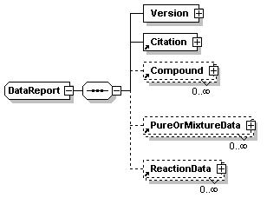
ThermoML: General structure
The next few slides give some detail of the structure of these ‘blocks’

Slide 26
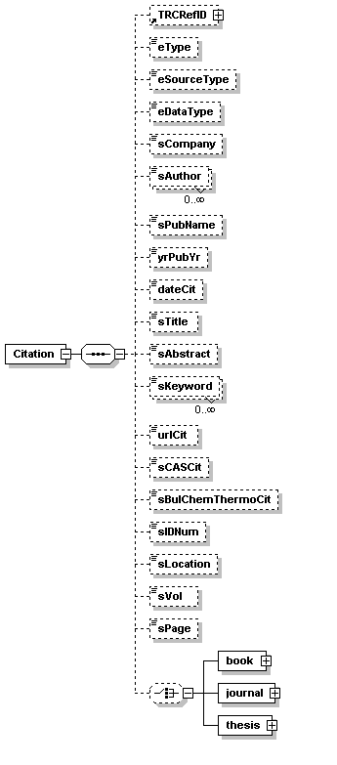
ThermoML:
Citation Block
Full bibliographic identifications from journals to books to websites to personal communications…

Slide 27
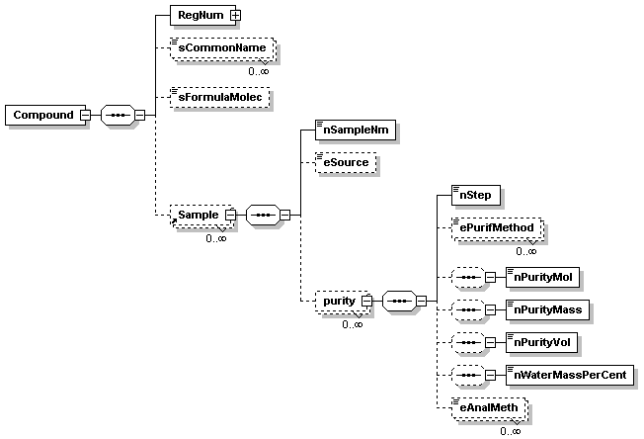
ThermoML: Compound & Sample Block
Includes:
Sample source
Purification steps & methods
Multiple analysis methods
Multiple analysis results

Slide 28
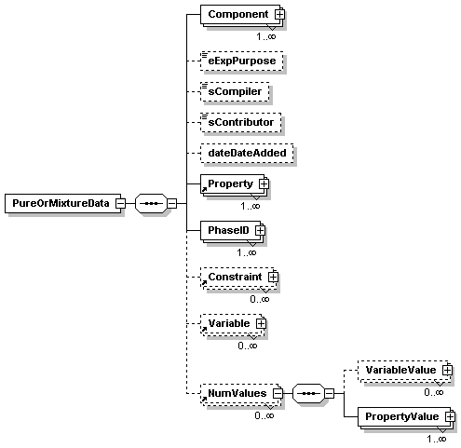
ThermoML: Pure Or Mixture Dataset Structure
Expanded in the next slide
properties, constraints, variables, and phases are defined, which give meaning to…
Numerical values
Allows data checks based on the Gibbs Phase Rule

Slide 29
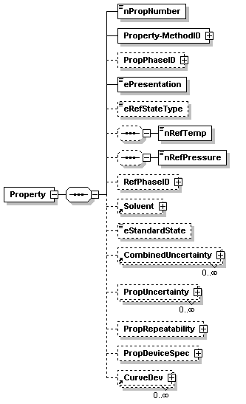
ThermoML: Property Description
Property & method description
Expanded in the next slide
Used for alternative property representations commonly reported.
(i.e., relative to pure solvent, relative to fixed T and p, etc.)
Uncertainty and precision info

Slide 30
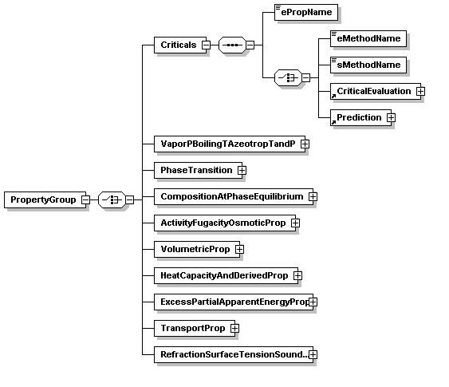
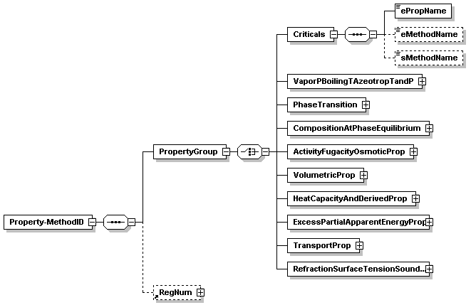
ThermoML: Property Specification
Criticals [complex]
ePropName [enumeration]
critical temperature, K
critical pressure, kPa
critical density, kg/m³
critical molar volume, m^{3‚}mol⁻¹
critical specific volume, m^{3‚}kg⁻¹
critical compressibility factor
lower consolute temperature, K
upper consolute temperature, K
lower consolute pressure, kPa
upper consolute pressure, kPa
What
How

Slide 31
ThermoML: Pure Or Mixture Dataset Structure
Property specification: expanded on previous slide
properties, constraints, variables, and phases are defined, which give meaning to…
Numerical values
Allows data checks based on the Gibbs Phase Rule
Expanded next…

Slide 32
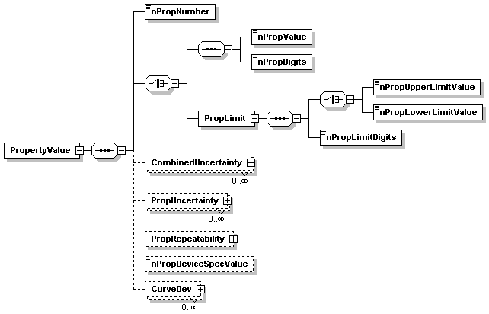
ThermoML: Numerical Property Values
Numerical values
Uncertainty information: Expanded later

Slide 33
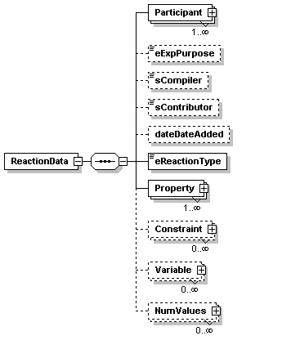
ThermoML: Reaction Data Block
Analogous to other properties w/o reactions

Slide 34
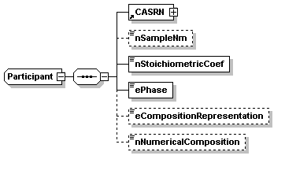
ThermoML: Reaction Participant
Main difference from other properties

Slide 35
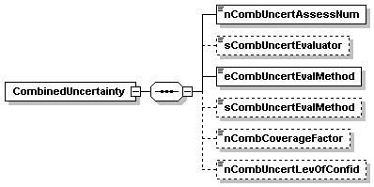
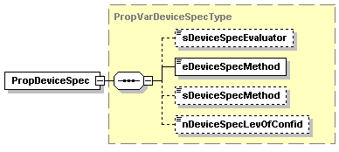
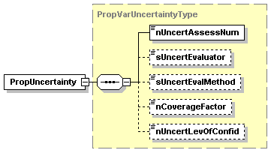
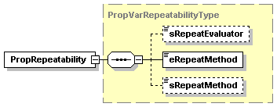
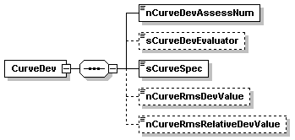
ThermoML: Specification of Uncertainty Information
Uncertainties
Precisions
Includes uncertainty for properties, variables, and constraints
Based on the Guide to the Expression of Uncertainty in Measurement (The GUM), ISO International Organization for Standardization), October 1993

Slide 36
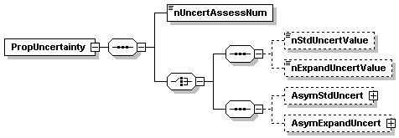

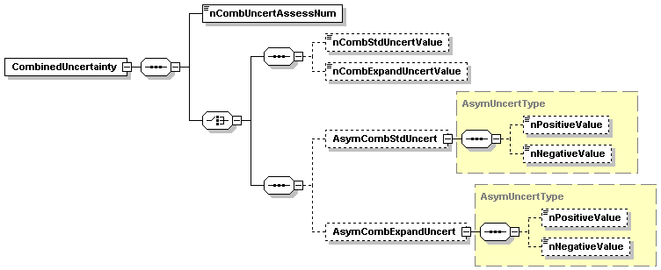

ThermoML: Uncertainty Values
Allows for multiple assessments

Slide 37
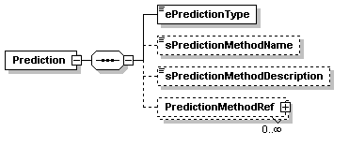
ThermoML: Predicted Data
No sample
Expanded methods

Slide 38
ThermoML: Predicted Data Types
ab initio
molecular dynamics
empirical or semi-empirical quantum
statistical mechanics
corresponding states
correlation
group contribution

